Slide 1
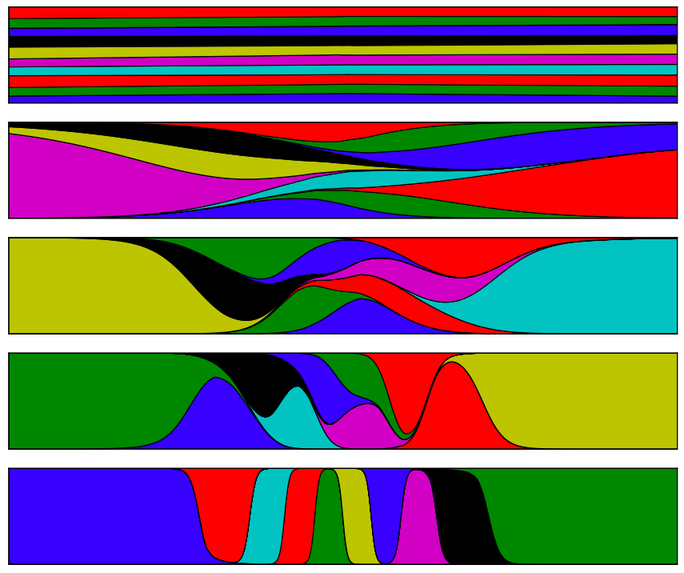

Demystifying Variational Autoencoders
Phuong et al. 2018
+ perspectives, causality, problems, and solutions.
Matthew Vowels 2019
For more see the Awesome List @ https://github.com/matthewvowels1/Awesome-VAEs
> 300 papers
@matt_vowels

Slide 2
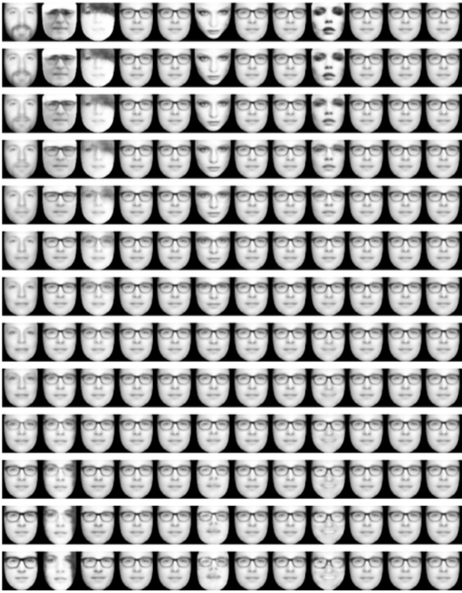
What is a VAE?
Embedding
Manifold
Subspace
Representation
Causal Factors
Generative Factors
Latent Factors
Used for:
Generation
Downstream tasks
Change detection
Debiasing
Denoising
Compression
…
Inference
Bottleneck
Generation

Slide 3
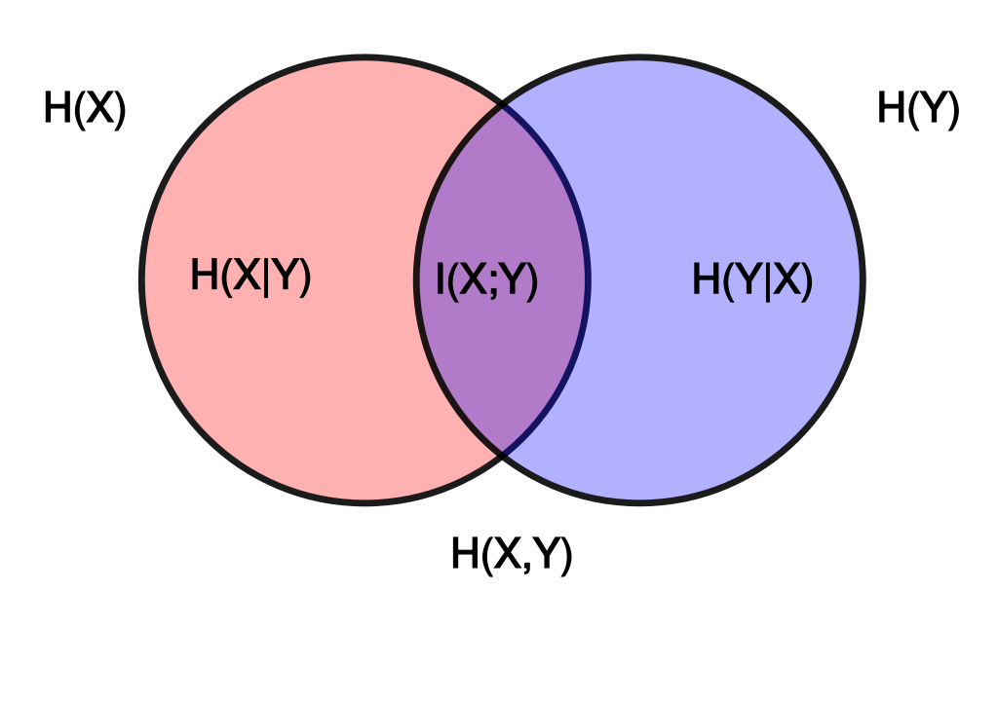
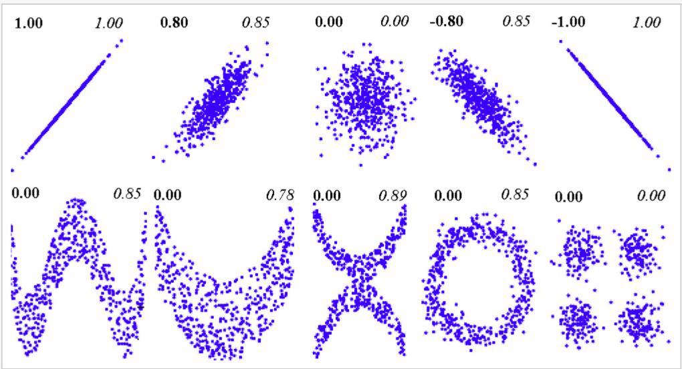
Some definitions
Entropy
Total Correlation
Mutual Information
Divergences and Integral Probability Metrics
Gao et al. 2019
Cover, Thomas 2006
Belghazi et al. 2018

Slide 4
Some definitions
Entropy
Total Correlation
Mutual Information
Divergences and Integral Probability Metrics
Gao et al. 2019
Cover, Thomas 2006

Slide 5
Some definitions
F-Divergences
Integral Probability metrics
KL
Hellinger
Pearson Chi^2
Jeffrey
Jensen-Shannon
Neyman Chi^2
Wasserstein (earth-mover)
MMD
Kolmogorov Smirnov
Total Variation
Arthur Gretton, 2019
Nowozin, 2019
Grover, Dhar, Ermon 2018

Slide 6
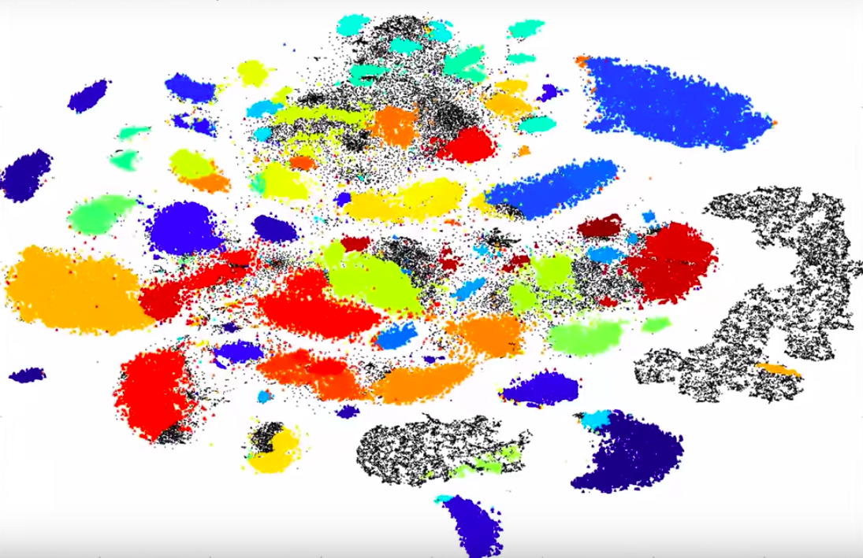
Overview
Motivation and Context
VAE Architecture
VAE Objective
Problems with VAEs and Solutions
Evaluation
What's Next?
Causal Interpretations

Slide 7
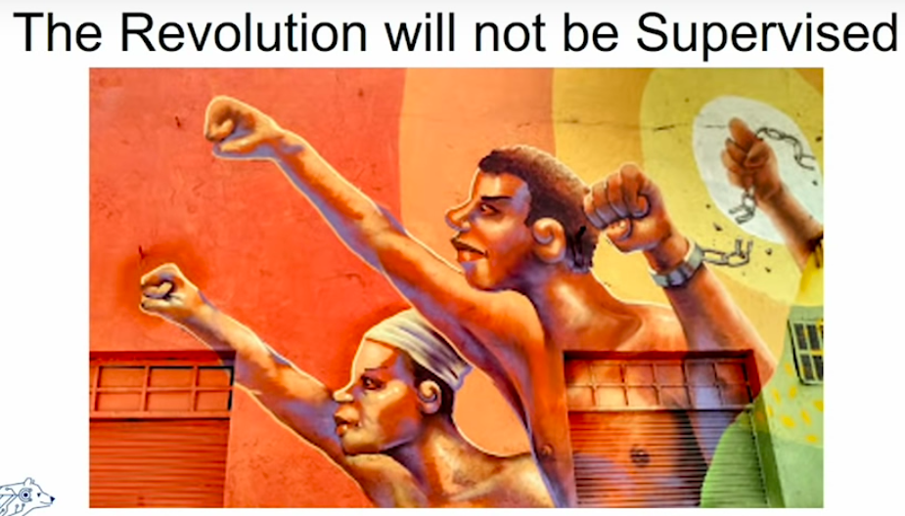
Motivation & Context
Efros 2019

Slide 8
Cuturi 2019
Modelling
distribution
data
Often we may want to parameterize a real-world distribution parametrically

Slide 9
Modelling
distribution
Fisher 1922

Slide 10
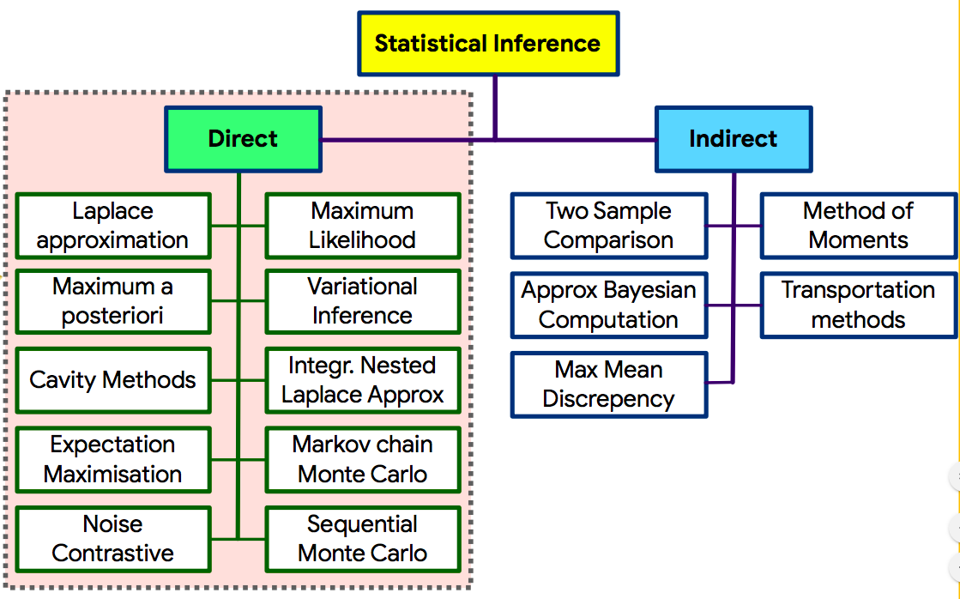
Some definitions
Shakir Mohamed, 2019

Slide 11
But… ‘unbiased and consistent density estimation is known to be impossible…’
Zhao et al. 2018; Efromovich 2010; Rosenblatt 1956

Slide 12




128 x 128 x 3 -> ~50k dimensions and 400k bits!
e.g. for MNIST we need a histogram with 10^236 probabilities (from 2^(28*28)) – no way to generalize outside of empirical dist.
Courville, Goodfellow, Bengio 2015; UC Berkeley CS294-198 2019, Abbeel, Chen, Ho, Srinivas

Slide 13
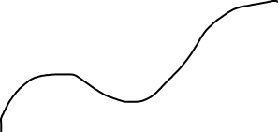
“…real-world data presented in high dimensional spaces are expected to concentrate in the vicinity of a manifold of much lower dimensionality, embedded in high dimensional input space.” Bengio, Courville, Vincent 2014
Even with ‘large’ datasets, the support for p(x) is often exponentially undersized across latent factors. [Zhao et al. 2018]

Slide 14
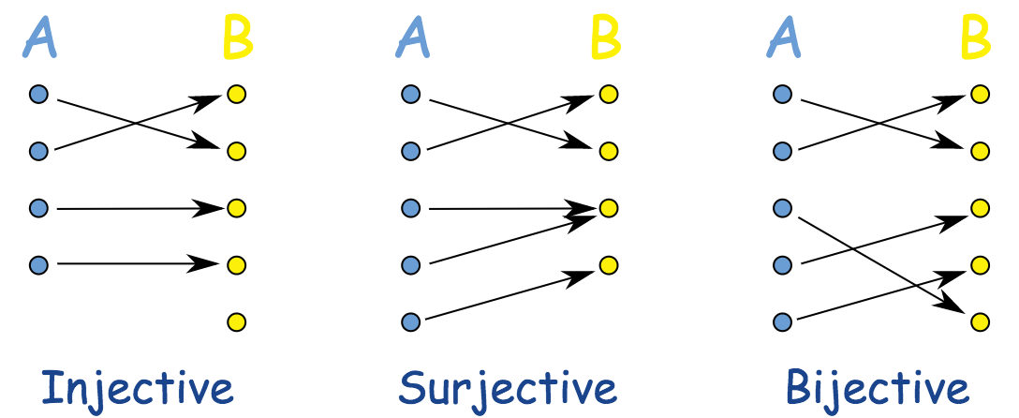
GOALS
Faithful reconstruction of the input sample
High sample quality (whether random samples or reconstructions)
Rich representations.
Approximate data distribution
Learn generative factors, remove nuisance factors, disentanglement
Compress
Heljakka, Solin, Kannala,2018;
Khemakhem, Kingma 2019;
Nowozin, 2019

Slide 15
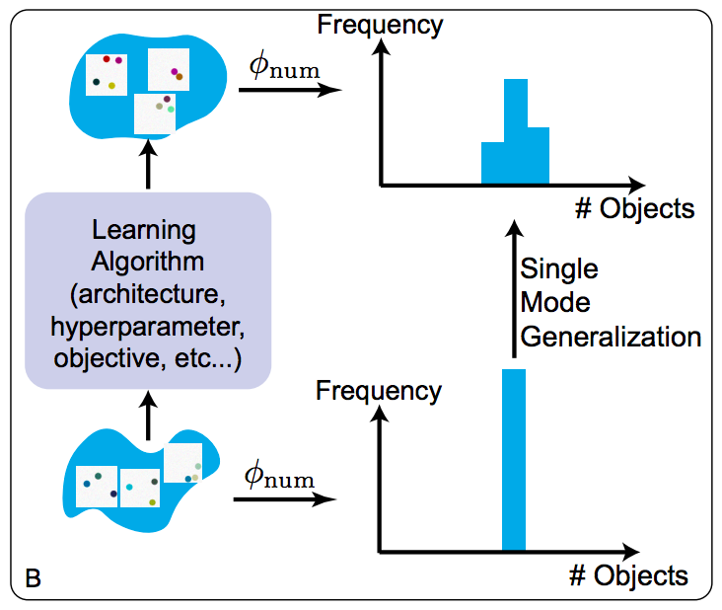
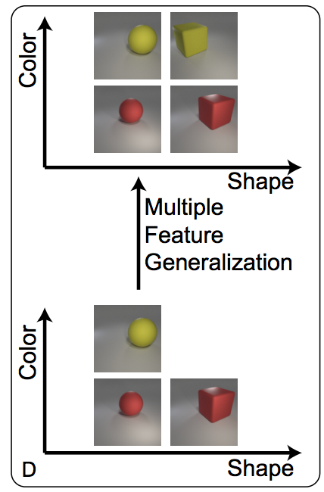
Zhao et al. 2018

Slide 16
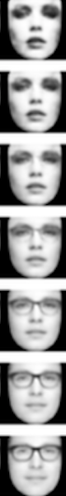

Interpolation
???
Learns some compact manifold of faces
rather than a simple lookup table.

Slide 17
Context – Approximate & Variational Inference
We can do unsupervised learning using generative models
Intractable
Latent space too high dimensional
Latent space too complex and no analytical form
Density approximation schemes:
Deterministic
Tractable analytical approximations to posterior (e.g. GMM, mean-field)
Stochastic
Sampling methods (e.g. MCMC, Gibbs, HMC)
Black-box and amortised inference methods e.g. VAE
VAEs allow us to leverage the power of deep learning for VI via the reparameterization trick and achieve efficient training, fast sampling, compression, representation learning, and generalization.
See ‘Advances in Variational Inference’ Zhang, Butepage, Kjellstrom, Mandt 2018

Slide 18
Context – Approximate & Variational Inference
Unsupervised, black-box, generative approaches:
GANS
AutoRegressive
Flow Based Models
DLVMs
See ‘Advances in Variational Inference’ Zhang, Butepage, Kjellstrom, Mandt 2018

Slide 19
Density Estimation Model types
“Generative models are providing the means to learn from a plethora of unlabeled data in order to model a complex data distribution… These models are evaluated by their ability to generate data that is similar to the input data distribution…” Maaloe, Fraccaro, Lievin, Winther 2019
UNSUPERVISED
Explicit/prescribed Density Models
AR (e.g. PixelRNN)
Flow (e.g. Real NVP, Flow++, NICE, FFJORD)
LVMs and Deep LVMs (e.g. VAE)
Implicit Density Models
GAN
We can get a likelihood or at least a bound
We can’t easily get likelihood estimation
(e.g. need KDE/Parzen)
They learn a deterministic mapping
from noise to samples
Abbeel, Chen, Ho, Srinivas, 2019

Slide 20
Density Estimation Model types
UNSUPERVISED
Explicit/prescribed Density Models
AR (e.g. PixelRNN)
Flow (e.g. Real NVP, Flow++, NICE)
LVMs and Deep LVMs (e.g. VAE)
Implicit Density Models
GAN
Sampling is Slow, but good density/mass est. and LL
No single representation layer or interpolations
Abbeel, Chen, Ho, Srinivas, 2019

Slide 21
Density Estimation Model types
UNSUPERVISED
Explicit/prescribed Density Models
AR (e.g. PixelRNN)
Flow (e.g. Real NVP, Flow++, NICE)
LVMs and Deep LVMs (e.g. VAE)
Implicit Density Models
GAN
Representation dimensionality same as input’s
No notion of embedding
Slow evaluation of LL if new x
Fast sampling and LL of samples
Abbeel, Chen, Ho, Srinivas, 2019

Slide 22
Density Estimation Model types
UNSUPERVISED
Explicit/prescribed Density Models
AR (e.g. PixelRNN)
Flow (e.g. Real NVP, Flow++, NICE)
LVMs and Deep LVMs (e.g. VAE)
Implicit Density Models
GAN
Stay tuned… “Jack of all trades” – Srinivas 2019
Abbeel, Chen, Ho, Srinivas, 2019

Slide 23
Density Estimation Model types
UNSUPERVISED
Explicit/prescribed Density Models
AR (e.g. PixelRNN)
Flow (e.g. Real NVP, Flow++, NICE)
LVMs and Deep LVMs (e.g. VAE)
Implicit Density Models
GAN
Less principled compared with density models?
Finickity
Difficult to train
Sample diversity limited
Likelihood evaluation difficult
But… Amazing samples
Abbeel, Chen, Ho, Srinivas, 2019

Slide 24
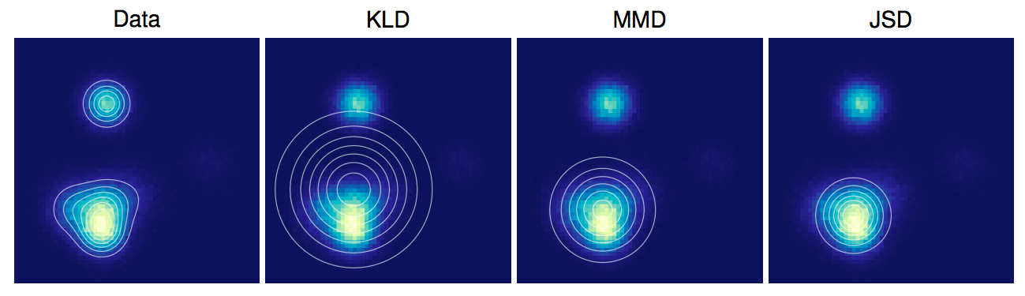
But…
Maximising LL does not always correspond with maximizing sample quality (and vice versa)
Different divergence metrics yield different results
Models should be evaluated from different perspectives and in light of their application!
Theis, van den Oord, Bethge 2016

Slide 25
VAE Architecture
Motivation and Context
VAE Architecture
VAE Objective
Problems with VAEs and Solutions
Evaluation
What's Next?
Causal Interpretations

Slide 26
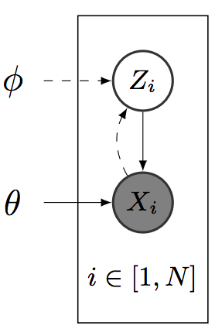
VAE architecture
Inference
Bottleneck
Generation
Bouchacourt,
Tomioka,
Nowozin 2017
(in AR and flow, all variables are observed)

Slide 27
VAE Objective
Motivation and Context
VAE Architecture
VAE Objective
Problems with VAEs and Solutions
Evaluation
What's Next?
Causal Interpretations
“Taking the form of a lower bound on the intractable model evidence, variational bounds provide surrogate targets that are more amenable to optimization.”
Rainforth et al. 2019

Slide 28
The simpler derivation…
ELBOs
Now exchange integral for expectation over q
Roeder et al. 2017
This identity trick is also used in the derivation for
IWAE

Slide 29
The more complex derivation…
MacKay 2003

Slide 30
The more complex derivation…
This is reverse KL and called ‘I-projection’
(as opposed to normal KL = Moment-projection)
Zero-forcing (as opposed to zero avoiding)
MacKay 2003

Slide 31
The more complex derivation…
We use the alternative 'normal’ KL in wake-sleep algo.
MacKay 2003

Slide 32
The more complex derivation cont…
Prior Regularisation
Reconstruction error

Slide 33
One more…
Abbeel, Chen, Ho, Srinivas, 2019

Slide 34
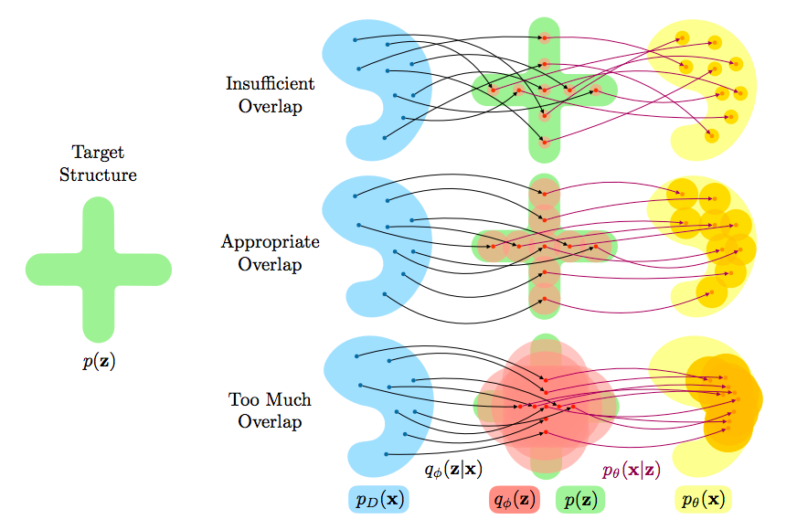
Lookup table behavior
Posterior collapse
Mathieu et al. 2019

Slide 35
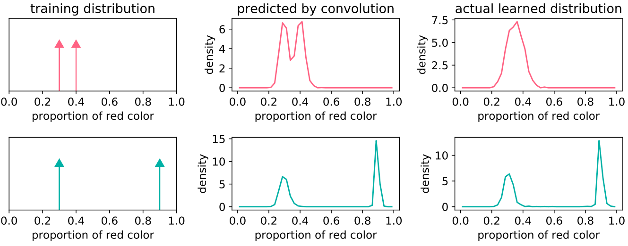
Like linear filtering / convolution?
Zhao et al. 2018

Slide 36
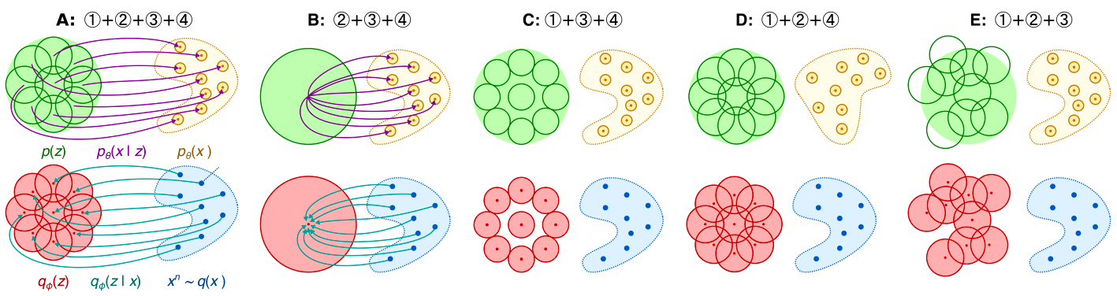
Esmaeili et al. 2019
Minimising this maximizes likelihood
Uniqueness of reconstruction
Mutual information
Matches inference marginal to prior

Slide 37
Esmaeili et al. 2019
Default VAE
Removing (1) means no need for a unique z for each x, (2) maps x to prior and latent code = dead
Removing (2) removes I(x;z) minimization, making x get mapped to unique z
Removing (3) means p(x) does not need to match q(x)
Removing (4) means q(z) does not need to match prior
Minimising this maximizes likelihood
Uniqueness of reconstruction
Mutual information
Matches inference marginal to prior

Slide 38
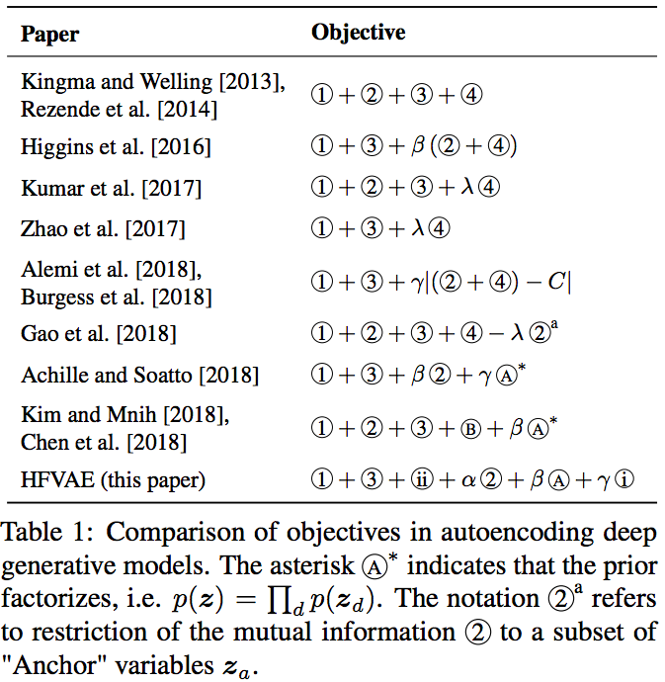
Esmaeili et al. 2019

Slide 39
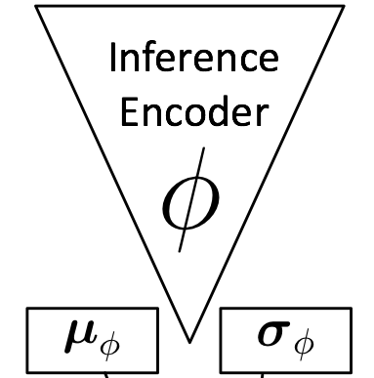
Reparameterisation Trick
We learn distribution parameters:
Inference
We need to sample from this posterior
Bottleneck
Generation
And then use the reparameterization trick!

Slide 40
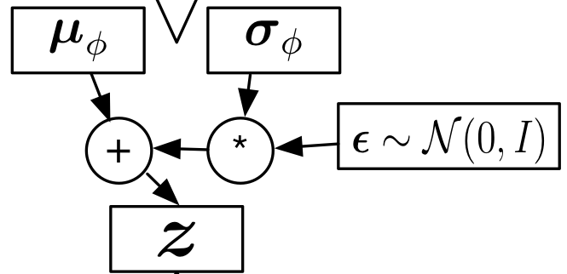
Reparameterisation Trick

Slide 41
The origins of reparameterisation
Also known as the ‘pathwise derivative’
Trying to optimize over an expectation with shared params
Abbeel, Chen, Ho, Srinivas, 2019

Slide 42
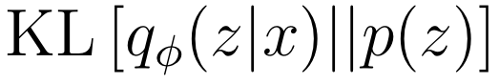
VAE architecture
‘No principled method exists to choose the optimal latent code dimension’ Lezama 2019
Inference
Encoder
Mean-field assumption
Generation
Decoder
Useful for compression too…
e.g. bits-back ANS (see Townsend 2019)
Reconstruction
Loss
Xing, 10-708, 2015

Slide 43
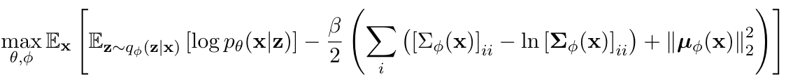
VAE architecture
Training Process:
1. Sample batch of images.
2. Find q(z|x) for each image (i.e. reparameterise N(0,I) and pass samples on to decoder.
3. Reconstruct input from these samples.
4. For each batch compute KL(q(z|x) || p(z)) and reconstruction loss (e.g. x-ent or L2)
5. Repeat 1.-4. until bored.
Usually we use an analytical form for KL.
If we have no analytical form then we do double-stochastic estimation.
How many samples depends on how close q is to p

Slide 44
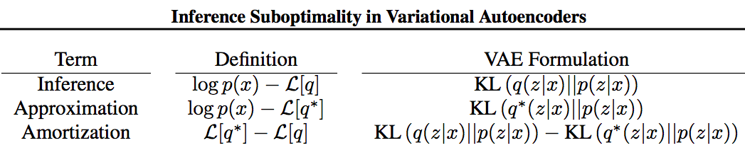
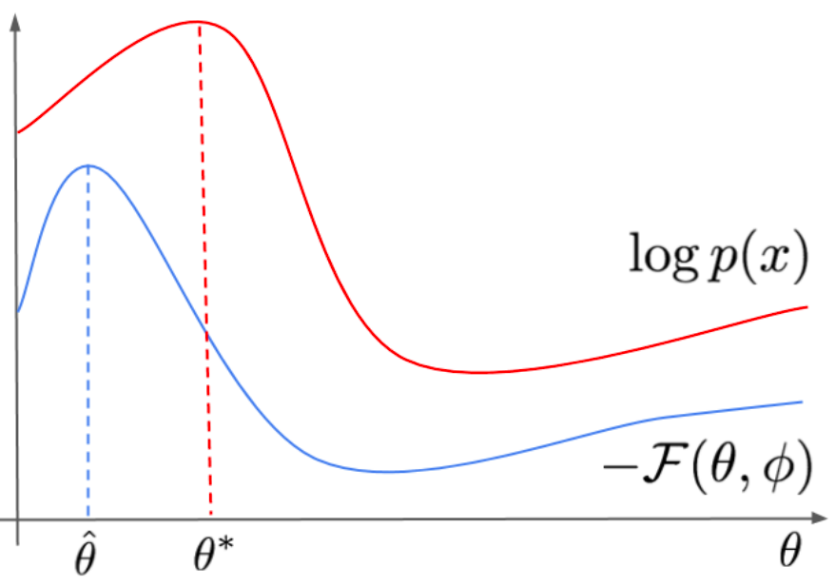
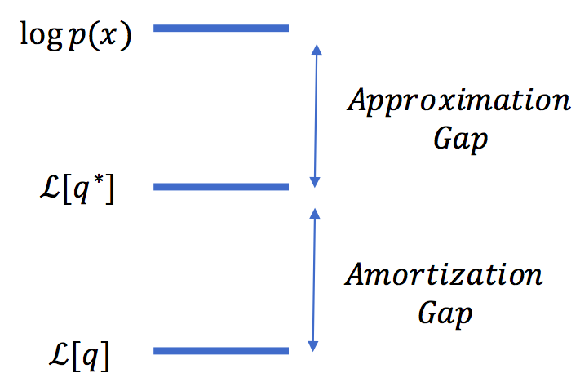
Cremer, Li, Duvenaud 2018
Van den Berg, Hasenclever, Tomczak, Welling, 2019

Slide 45
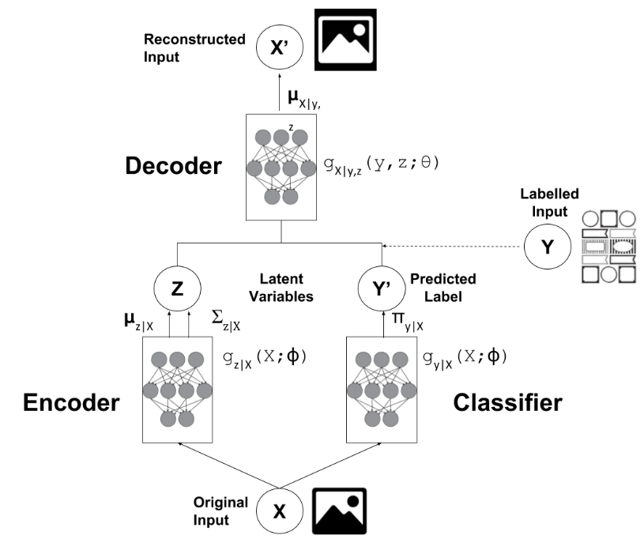
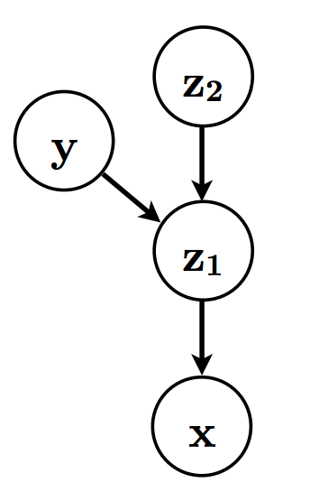
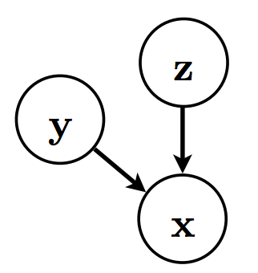
Keng 2017, Kingma et al. 2014, Courville 2017

Slide 46
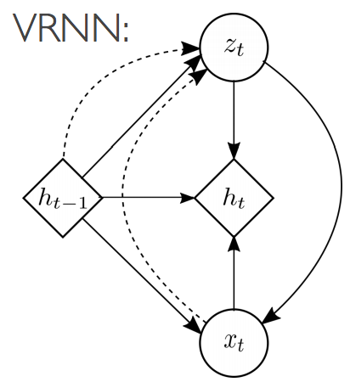
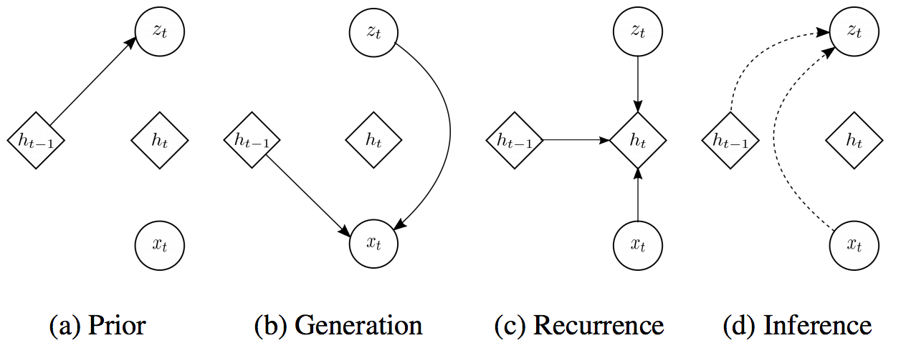
Courville 2017

Slide 47
A note on state space modelling
For an observation sequence X_T we can encode corresponding state sequences Z_t
Gregor et al. 2019

Slide 48
Problems with VAEs
Motivation and Context
VAE Architecture
VAE Objective
Problems with VAEs and Solutions
Evaluation
What's Next?
Causal Interpretations

Slide 49
Problems with VAEs
Inference Suboptimality and NLL Tradeoff
Disentanglement
Blurry Images

Slide 50
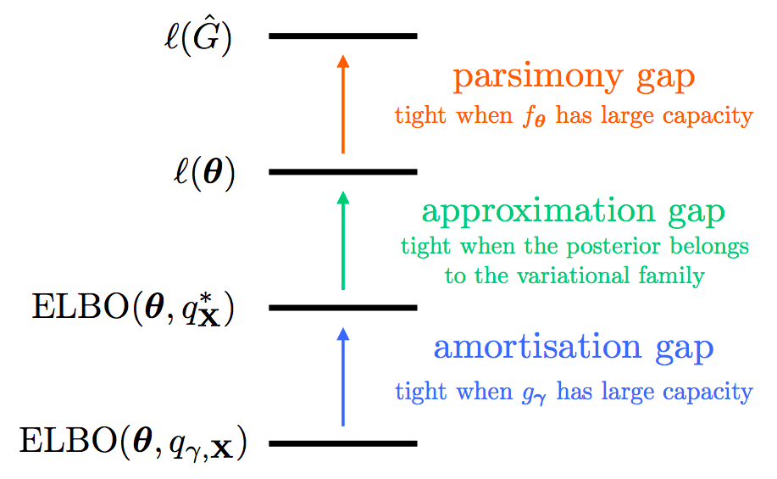
Inference Suboptimality
We will see that MLE is not an ideal approach to training DLVM
Expressive decoders reduce informativeness of latent space whilst achieving higher LL
Mattei, Frellsen 2018; Phuong et al. 2018; Alemi et al. 2018; Tschannen 2018; Zhao et al. 2018; Chen et al. 2018

Slide 51
What is Mutual Information?

Slide 52
I(z;x) is the ‘index-code’ mutual information

Slide 53
What does this look like in practice?

Slide 54
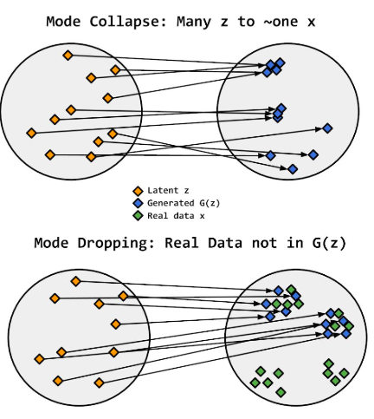
Equivalent in GANs?
Brock, 2019

Slide 55
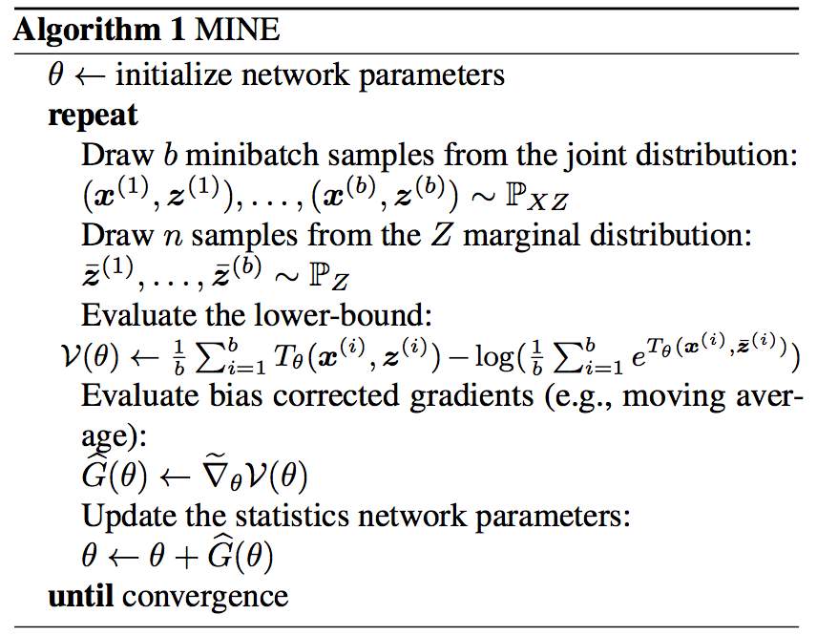
One recently established way to calculate it….
Using Donsker-Varadhan and Frenchel duality,
MI can be written as a lower bound estimated as:
MINE, Belghazi et al. 2018

Slide 56
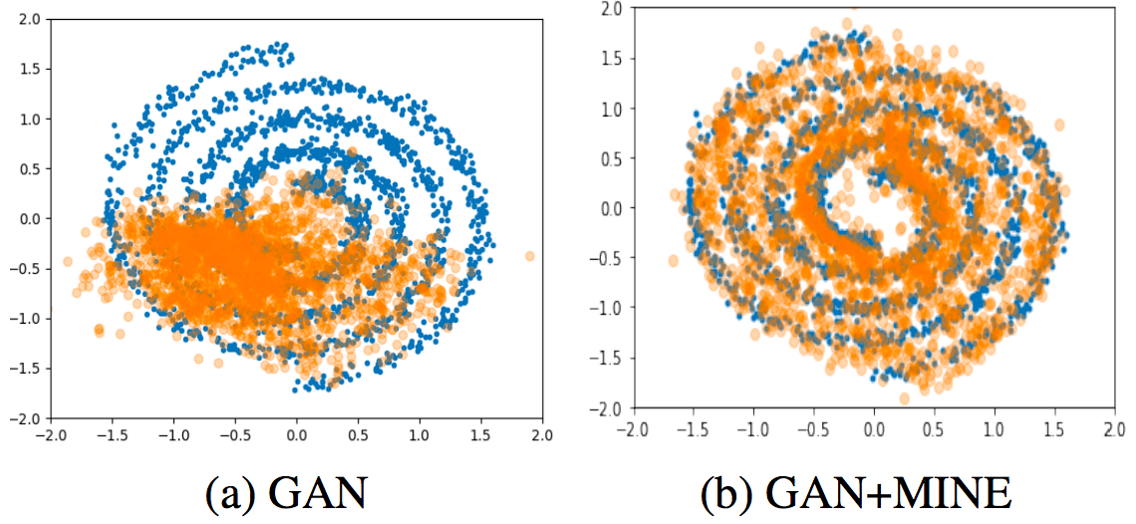
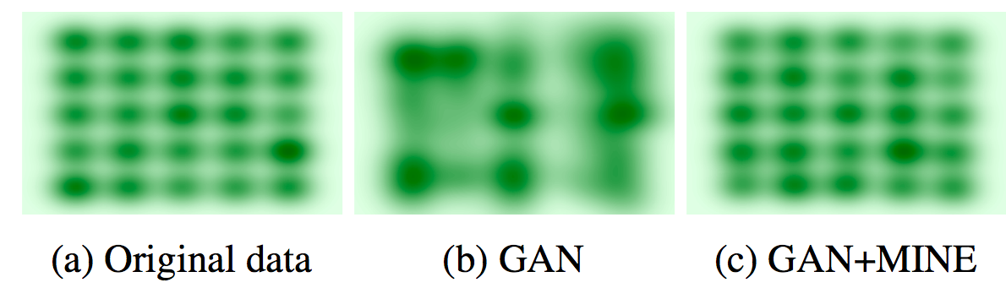
One recently established way to calculate it easily….
MINE, Belghazi et al. 2018

Slide 57
Inference Suboptimality - Latent Collapse
Information Bottleneck paradigm: maximise I(z,y), minimise I(x,z)
Recall from Zhang et al. 2017 that a network can be trained on CIFAR-10 with randomized labels and still achieve good results!
Weights’ information complexity is inversely related to generalisability
Tishby et al. 1999
Moyer et al. 2018
Achille, Soato, 2018

Slide 58
Inference Suboptimality - Latent Collapse
Limited Decoders
Low
Low
High
High
Flexible/Powerful Decoders
Abbeel, Chen, Ho, Srinivas, 2019; Makzhani, Frey 2017; Lucas et al. 2019

Slide 59
Inference Suboptimality – Objective Mods
Zhao et al. 2018, replace last term with MMD
Chen et al. 2018 – importance sampling estimate of TC, can set lambda1 to 0
Kim, Minh 2018 – adversarial estimation of TC
See Tschannen, Bachem, Lucic 2018

Slide 60
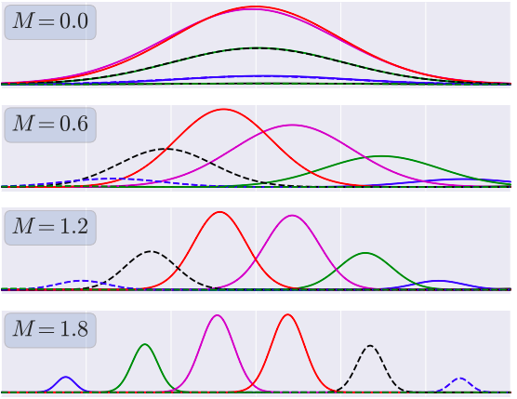
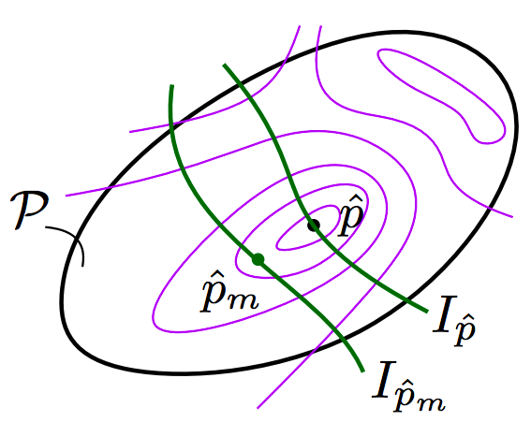
Inference Suboptimality – Objective Mods
Phuong et al 2018 use the penalty function method
Any deviation of I(.,.) from M is penalized linearly.

Slide 61
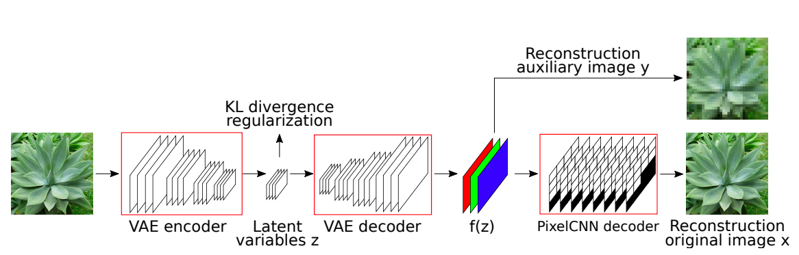
Inference Suboptimality - Architecture mods
Lucas, Verbeek 2018

Slide 62
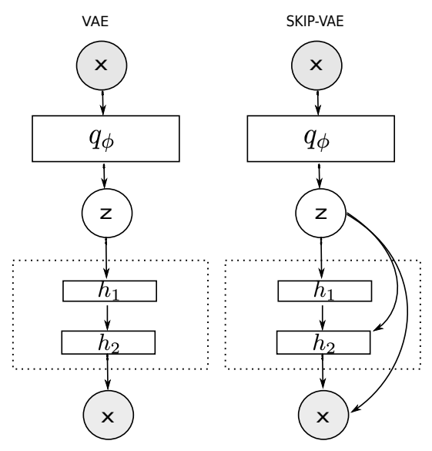
Inference Suboptimality - Architecture mods
Dieng et al. 2019

Slide 63
Inference Suboptimality
Hierarchies
LadderVAEs (e.g. Sonderby et al. 2016, Zhao et al. 2017, Maaloe et al. 2019)
VAEs with PGMs (e.g. SVAE - Johnson et al. 2016)
Discrete Variables
VQ-VAE (van den Oord et al. 2018)
JointVAE (Dupont 2018)
More powerful priors and/or more powerful approximate posteriors (see using flow or AR model – e.g. IAF-VAE)
[Phuong et al. 2018; Huszar 2017]

Slide 64
Inference Suboptimality
Falk, 2019; Rezende, Viola 2018 (GECO)
Annealing or hyperparameter learning…

Slide 65
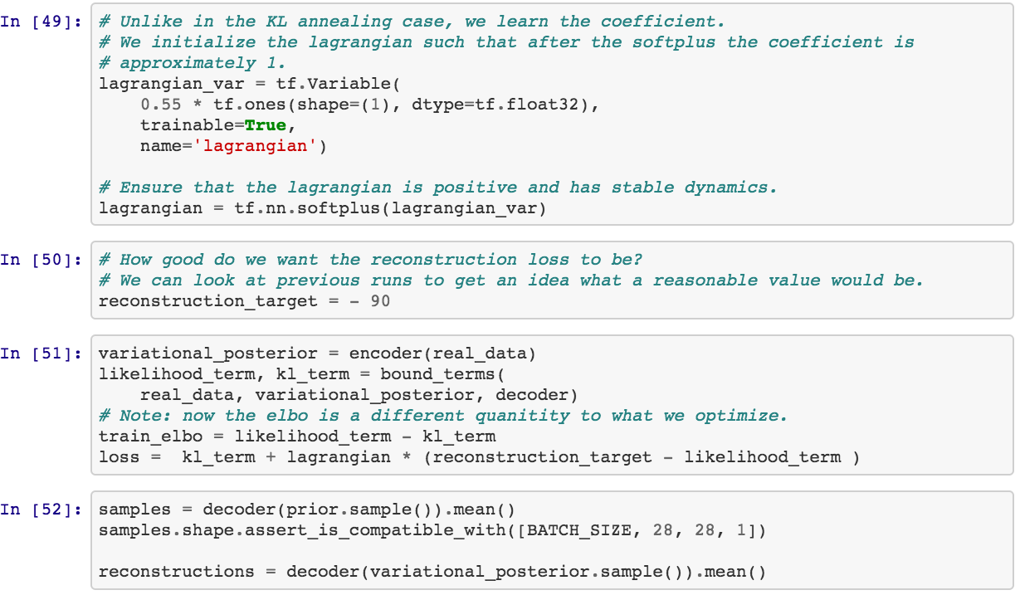
Inference Suboptimality
https://github.com/mlss-2019/tutorials/blob/master/variational_inference/MLSS2019_VAEs_solution.ipynb
Falk, 2019; Rezende, Viola 2018 (GECO)

Slide 66
Inference Suboptimality – a Rate-Distortion Perspective
Entropy
Distortion
Rate
Beta-VAE objective is therefore:
Tishby et al. 2000
Alemi et al. 2018
Tschannen et al. 2018

Slide 67
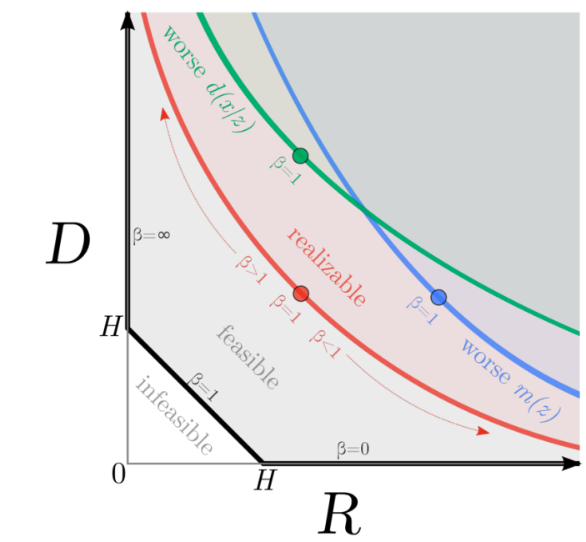
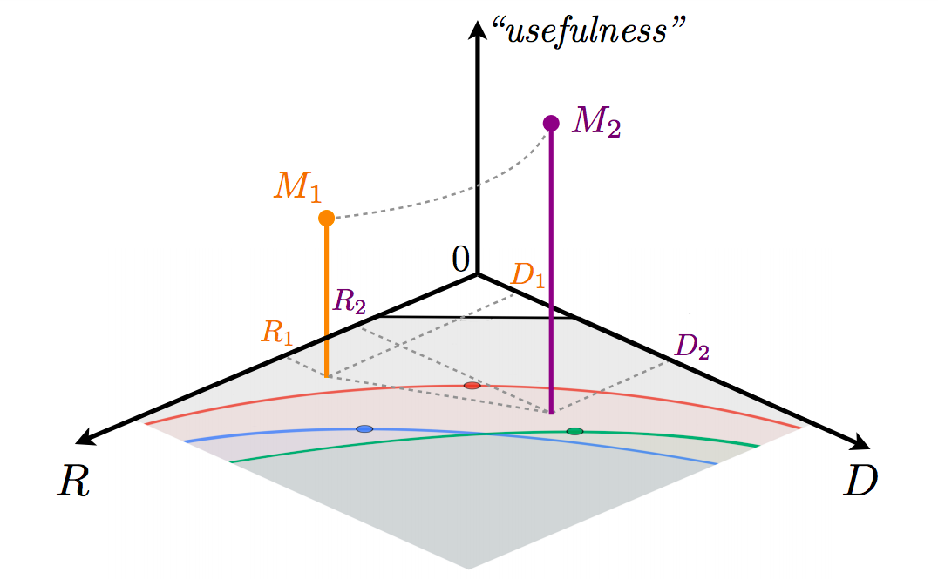
Inference Suboptimality – a Rate-Distortion Perspective
Review: Tschannen et al. 2018

Slide 68
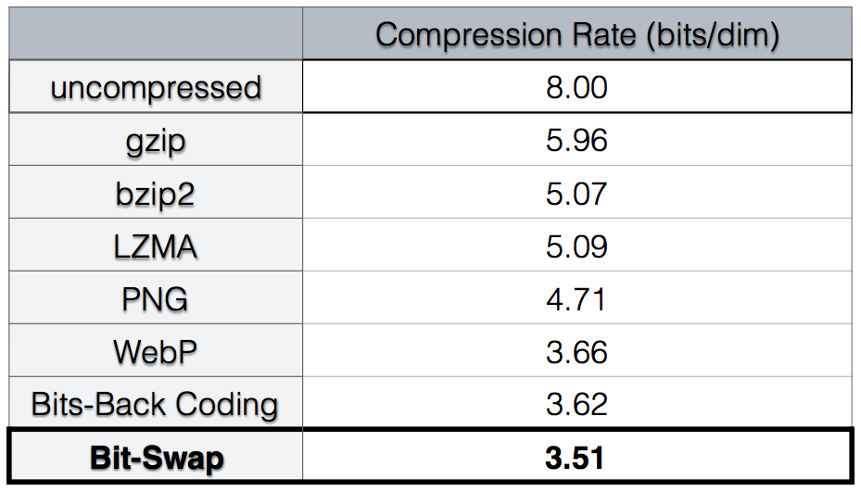
Inference Suboptimality – a Rate-Distortion Perspective
See Bits-back and bit-swap for VAEs for compression
Bit-swap w/ hierarchical VAEs by
Kingma et a. 2019
https://www.youtube.com/watch?v=gR-P41Pis24

Slide 69
Inference Suboptimality - Latent Collapse Summary
‘KL Varnishing’
We approximately optimize a marginal LL in the hope of producing the desired effect on the joint distribution p (x,z).
The approach is unreliable although it works when the marginal imposes strong constraints on the joint distribution, such as when the decoder has limited capacity and the model is forced to use the latent structure to reach a high likelihood.
However, in the high-capacity regime (e.g. when p(x|z) = p(x) is close to achievable) the task of density estimation becomes disconnected from the goal of representation learning
[Phuong et al. 2018; Huszar 2017]

Slide 70
Blurry Images
L2 loss (e.g. see Dosovitskiy, Brox 2016)
“VAES learn latent variable representations that abstract away from low-level details, but model pixels as conditionally independent given the latent variables. This renders the generative model computationally efficient but the lack of low level structure modeling leads to overly smooth and blurry samples” (Lucas, Verbeek 2018)
Images do not have gaussian structure (Zhao, Song, Ermon, 2017)
Poor decoder expressivity Maaloe Fraccaro Lievin, Winther 2019

Slide 71
Disentanglement
A vector representation is called a disentangled representation with respect to a particular decomposition of a symmetry group into subgroups, if it decomposes into independent subspaces, where each subspace is affected by the action of a single subgroup, and the actions of all other subgroups leave the subspace unaffected.
Higgins et al. 2018
e.g. rotation and translation are both symmetries of an object

Slide 72
Disentanglement
“a symmetry of an object is a transformation that leaves certain properties of the object invariant. For example, translation and rotation are symmetries of objects – an apple is still an apple whether it is placed on a table or in a bag, and whether it rolls on its side or remains upright.”
Higgins et al. 2018
e.g. rotation and translation are both symmetries of an object

Slide 73
Disentanglement – Why is it useful?
Improved results for downstream tasks
Contribute understanding to underlying generative structure
Can be used to acquire representations invariant to certain factors
Useful for ‘cleaning’ up images (e.g. removing nuisance/noise)
e.g. rotation and translation are both symmetries of an object

Slide 74
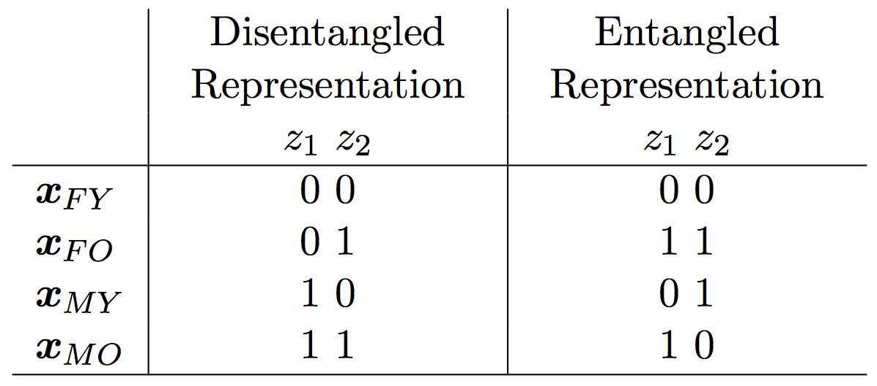
Disentanglement – Impossible?
Dai, Wipf 2019

Slide 75
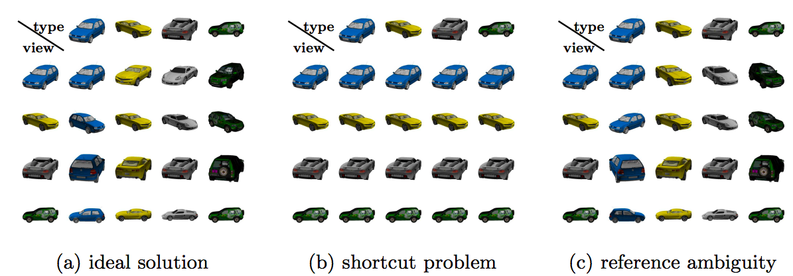
Disentanglement – Impossible?
Szabo et al. 2018

Slide 76
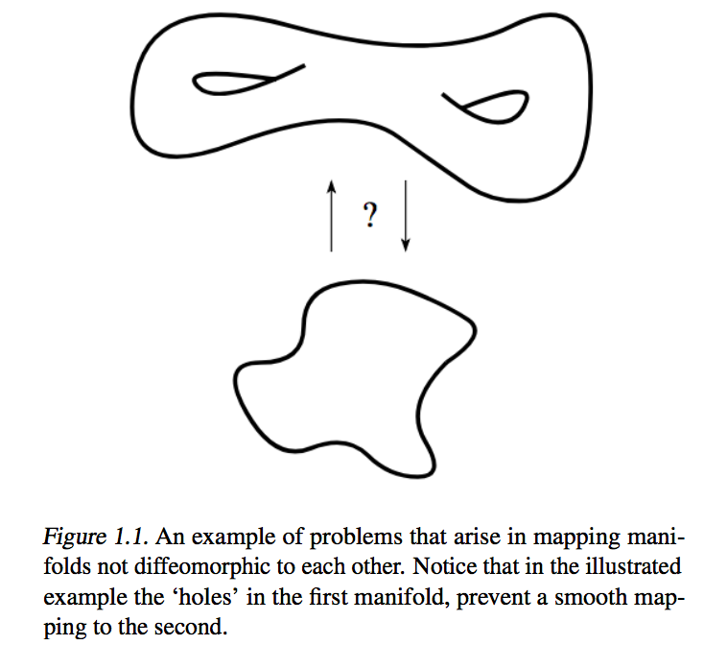
Disentanglement – Also…
‘In some cases the underlying factors that generated a dataset have a certain geometrical/topological structure that cannot be captured with the traditional Euclidean latent variables’
This is known as ‘manifold mismatch’
Rey 2019
Falorsi et al. 2018
Rey 2019, Davidson et al. 2018, Falorsi et al. 2018

Slide 77
Disentanglement – Quantitative Assessment
METRICS
MIG (Chen et al. 2018)
FactorVAE metric (Kim, Minh 2018)
Beta-VAE metric (Higgins et al. 2017)
Informativeness, Completeness and Disentanglement (Eastwood & Williams 2018)
Interventional Robustness (Suter et al 2019)
Separated Attribute Predictability (Kumar et al. 2018)
Locatello, Abbati, Rainforth, Bauer, Scholkopf, Bachem 2019

Slide 78
Disentanglement – Quantitative Assessment
METRICS
MIG (Chen et al. 2018)
FactorVAE metric (Kim, Minh 2018)
Beta-VAE metric (Higgins et al. 2017)
Informativeness, Completeness and Disentanglement (Eastwood & Williams 2018)
Interventional Robustness (Suter et al 2019)
SAP (Kumar et al. 2018)
Uses pairwise mutual information
Locatello, Abbati, Rainforth, Bauer, Scholkopf, Bachem 2019

Slide 79
Disentanglement – Quantitative Assessment
METRICS
MIG (Chen et al. 2018)
FactorVAE metric (Kim, Minh 2018)
Beta-VAE metric (Higgins et al. 2017)
Informativeness, Completeness and Disentanglement (Eastwood & Williams 2018)
Interventional Robustness (Suter et al 2019)
SAP (Kumar et al. 2018)
Intervenes on true factors to check variance of inferred factors
Locatello, Abbati, Rainforth, Bauer, Scholkopf, Bachem 2019

Slide 80
Disentanglement – Quantitative Assessment
METRICS
MIG (Chen et al. 2018)
FactorVAE metric (Kim, Minh 2018)
Beta-VAE metric (Higgins et al. 2017)
Informativeness, Completeness and Disentanglement (Eastwood & Williams 2018)
Interventional Robustness (Suter et al 2019)
SAP (Kumar et al. 2018)
Uses classifier to predict which factor is fixed from the embedding
Locatello, Abbati, Rainforth, Bauer, Scholkopf, Bachem 2019

Slide 81
Disentanglement – Quantitative Assessment
METRICS
MIG (Chen et al. 2018)
FactorVAE metric (Kim, Minh 2018)
Beta-VAE metric (Higgins et al. 2017)
Informativeness, Completeness and Disentanglement (Eastwood & Williams 2018)
Interventional Robustness (Suter et al 2019)
SAP (Kumar et al. 2018)
Based on entropy that a dimension in the embedding is useful for predicting the true factors, and vice versa
Locatello, Abbati, Rainforth, Bauer, Scholkopf, Bachem 2019

Slide 82
Disentanglement – Quantitative Assessment
METRICS
MIG (Chen et al. 2018)
FactorVAE metric (Kim, Minh 2018)
Beta-VAE metric (Higgins et al. 2017)
Informativeness, Completeness and Disentanglement (Eastwood & Williams 2018)
Interventional Robustness (Suter et al 2019)
SAP (Kumar et al. 2018)
Intervene and assess changes in embedded factors
Locatello, Abbati, Rainforth, Bauer, Scholkopf, Bachem 2019

Slide 83
Disentanglement – Quantitative Assessment
METRICS
MIG (Chen et al. 2018)
FactorVAE metric (Kim, Minh 2018)
Beta-VAE metric (Higgins et al. 2017)
Informativeness, Completeness and Disentanglement (Eastwood & Williams 2018)
Interventional Robustness (Suter et al 2019)
SAP (Kumar et al. 2018)
Gap in classification error between most predictive embedded factors
Locatello, Abbati, Rainforth, Bauer, Scholkopf, Bachem 2019

Slide 84
Disentanglement – Qualitative Assessment

Slide 85
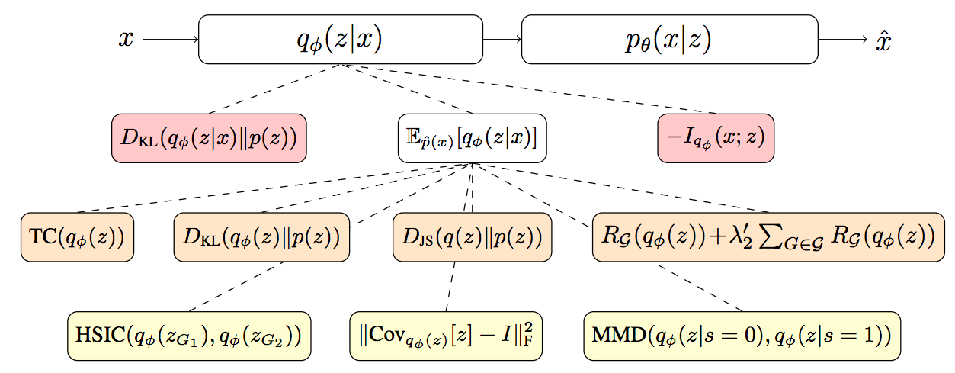
Disentanglement – How to achieve it?
Unsupervised methods:
Modifications to objective… but these don’t really work!
Tschannen et al. 2018

Slide 86
Disentanglement – How to achieve it?
Unsupervised methods:
Modifications to objective… but these don’t really work!
Higgins et al. 2017
Kumar et al. 2018
Lopez et al. 2018
Between grp
Esmaeili et al. 2018
Within grp
Tschannen et al. 2018

Slide 87
Disentanglement – How to achieve it?
Unsupervised methods:
Modifications to objective… but these don’t really work!
Incorporating Supervision :
Introducing cycle-consistency (e.g. Jha et al. 2018)
Introducing adversariality (e.g. Mathieu et al. 2016)
Training partitions of the network (e.g. Kulkarni et al. 2015)
Injecting labels (e.g. Lample et al. 2017)

Slide 88
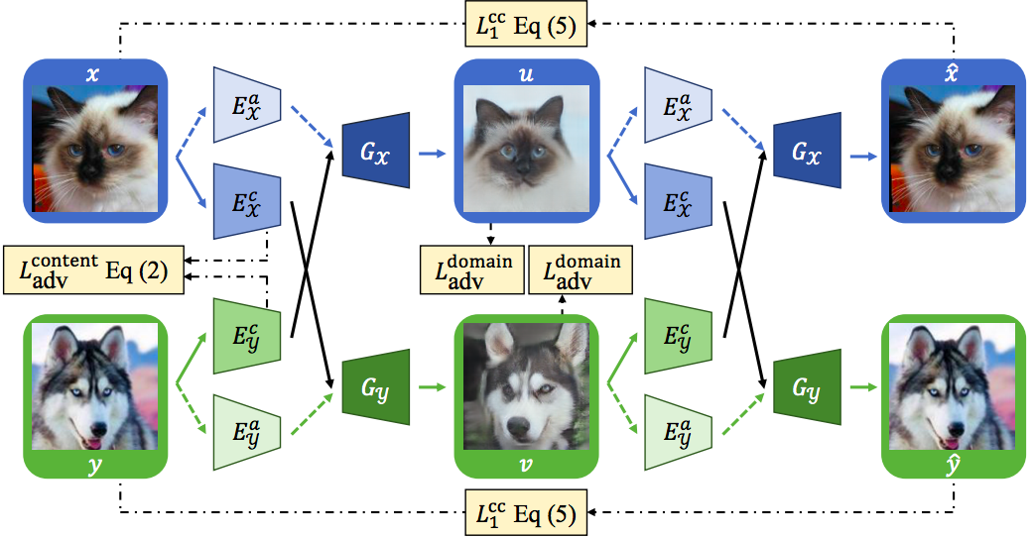
Disentanglement – How to achieve it?
Unsupervised methods:
Modifications to objective… but these don’t really work!
Incorporating Supervision :
Introducing cycle-consistency (e.g. Jha et al. 2018)
Introducing adversariality (e.g. Mathieu et al. 2016)
Training partitions of the network (e.g. Kulkarni
Lee et al. 2018

Slide 89
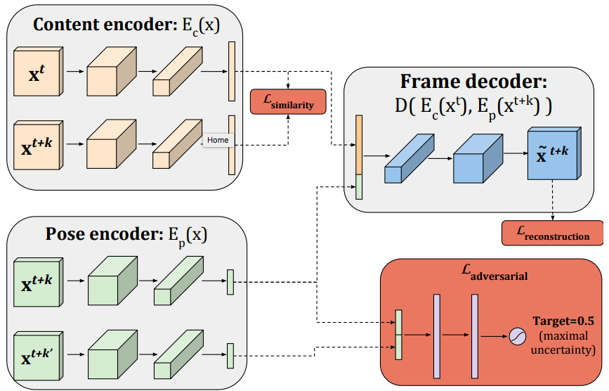
Disentanglement – How to achieve it?
Unsupervised methods:
Modifications to objective… but these don’t really work!
Incorporating Supervision :
Introducing cycle-consistency (e.g. Jha et al. 2018)
Introducing adversariality (e.g. Mathieu et al. 2016)
Denton, Birodkar 2017

Slide 90
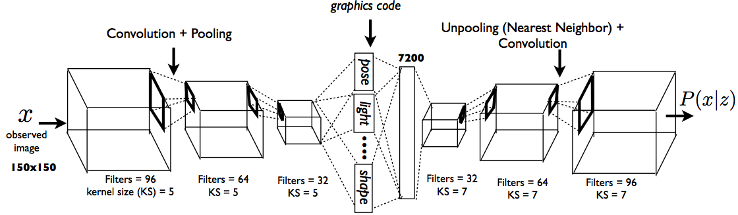
Disentanglement – How to achieve it?
Unsupervised methods:
Modifications to objective… but these don’t really work!
Incorporating Supervision :
Introducing cycle-consistency (e.g. Jha et al. 2018)
Introducing adversariality (e.g. Mathieu et al. 2016)
Training partitions of the network (e.g. Kulkarni et al. 2015)

Slide 91

Disentanglement – How to achieve it?
Abid, Zou 2019

Slide 92

Disentanglement – How to achieve it?
Unsupervised methods:
Modifications to objective… but these don’t really work!
Incorporating Supervision:
Injecting labels (e.g. Lample et al. 2017)

Slide 93

Causality
Motivation and Context
VAE Architecture
VAE Objective
Problems with VAEs and Solutions
Evaluation
What's Next?
Causal Interpretations
“All the impressive achievements of deep learning amount to just curve fitting”
Pearl 2018
“Representation learning should move towards representations of causal world models.”
Scholkopf 2019

Slide 94
Causality
Becoming increasingly popular (see Scholkopf, Huszar, Blei, Pearl, Ruocheng, Louizos, Welling etc.)
Relevant for de-biasing, disentanglement, fair encodings
Important for understanding black-box inference
Insights for latent variables and generative structure

Slide 95
Causality
Alt.
Temp.
Temp.
Alt.
Peters, Janzing, Scholkopf 2017

Slide 96
Causality
q(z) for VAE
then
if
and
then
if
and

Slide 97
Causality
q(z) for VAE
then
if
and
We want this!
then
if
and

Slide 98
Causality
q(z) for VAE
then
if
and
We want this!
This relates to semi-supervised learning: SSL will not work if X = cause and Y = effect, because X only tells us more about P(x) which is irrelevant because the prediction requires information about independent P(y|x). Peters, Janzing, Scholkopf 2017 p. 72. e.g. consider handwritten digit task (anti-causal).

Slide 99
Causality
Many problems may be amenable to incorporation of domain knowledge/inductive bias that helps our algorithm learn true structure in the data
e.g. With time… Barometer falls BEFORE - but does not cause – the rain.
Interventional robustness will allow us to explore asymmetries (e.g. changing the value of the barometer by hand will not change the distribution of rainfall)
This is one way to test disentanglement…
Peters, Janzing, Scholkopf 2017

Slide 100
Evaluation
Motivation and Context
VAE Architecture
VAE Objective
Problems with VAEs and Solutions
Evaluation
What's Next?
Causal Interpretations

Slide 101
Our original goals…
Faithful reconstruction of the input sample
High sample quality (whether random samples or reconstructions)
Rich representations.
Approximate data distribution
Learn generative factors, remove nuisance factors, disentanglement
Compress
Interpolation
Generalisation

Slide 102
Evaluation
LL (nats or bpd)
Reconstructions
Samples
Disentanglement
Interpolations
Rate-distortion characteristic
Latent space geometry

Slide 103

Evaluation
Latent space geometry

Slide 104



Evaluation
Latent space geometry
Spatial Broadcast Decoder
Watters et al. 2019
(also see CoordConv Liu et al. 2018
https://arxiv.org/abs/1807.03247)
Beta-VAE
Higgins et al. 2017
FactorVAE
Kim, Minh 2018

Slide 105
Evaluation
LL (nats or bpd)
Reconstructions
Samples
Disentanglement
Interpolations
Rate-distortion characteristic
Latent space geometry
Datasets

Slide 106
Evaluation - Datasets
dSprites [Matthey et al. 2017]
SmallNORB [Huang, LeCun 2004]
Cars3D [Reed et al. 2015]
3dshapes [Burgess, Kim 2018]
Disentanglement Dataset [Gondal et al. 2019]

Slide 107
What’s Next?
Motivation and Context
VAE Architecture
VAE Objective
Problems with VAEs and Solutions
Evaluation
What's Next?
Causal Interpretations

Slide 108


SOTA
VQ-VAE (2) (van den Oord et al. 2017, Razavi et al. 2019)
target

Slide 109

What’s Next?
UC Berkeley CS294-198 2019, Abbeel, Chen, Ho, Srinivas

